Slide 1
PyTorch introduction
서울대 전기정보공학부
명예교수 성원용
Many slide from
David Völgyes
Jingfeng

Slide 2
Outline
IN5400 Machine learning for image analysis, 2020 spring
GPU and Deep learning frameworks PyTorch
PyTorch
torch.tensor
Computational graph
Automatic differentiation (torch.autograd)
CreatingData loading and preprocessing (torch.utils)
Useful functions (torch.nn.functional)
the model (torch.nn)
Optimizers (torch.optim)
Save/load models
Page 2 / 84

Slide 3
1. Deep learning framework
Speed – deep learning requires a lot of computation
Leveraging the power of GPGPU (General Purpose Graphics Processing Unit)
Deep learning model training heavily uses backpropagation for weight updates, which is very complex for programming. Autograd solves this problem.
Easy of use and reuse

Slide 4
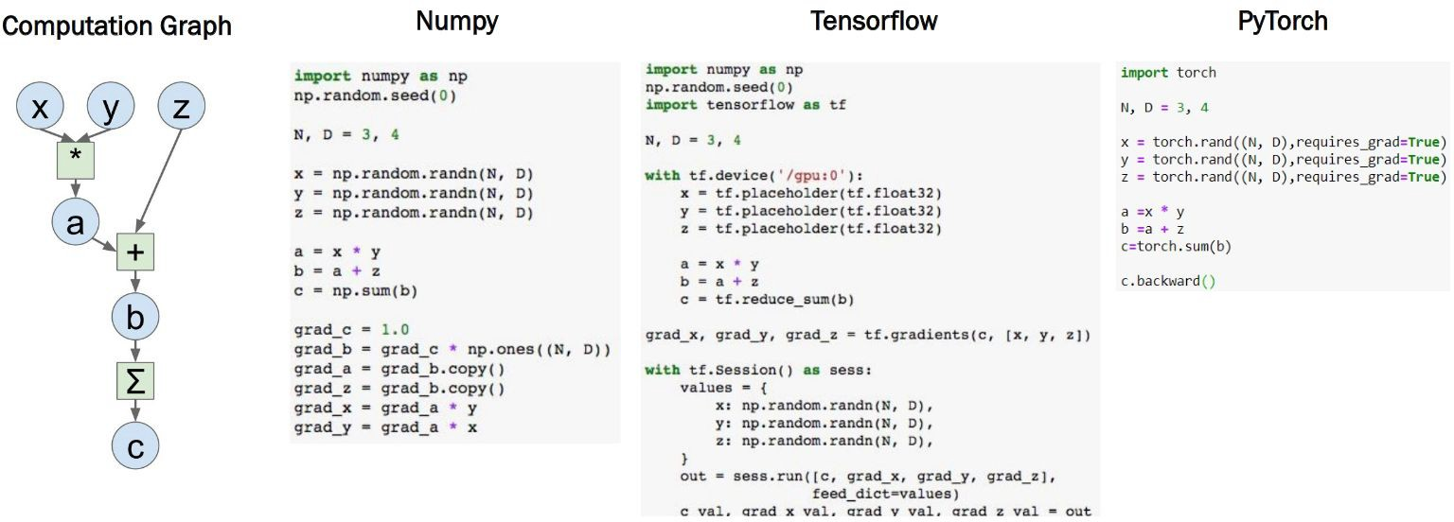
Why PyTorch?

Slide 5
Getting Started with PyTorch
Installation
Via Anaconda/Miniconda:
conda install pytorch
Via pip:
pip3 install torch

Slide 6
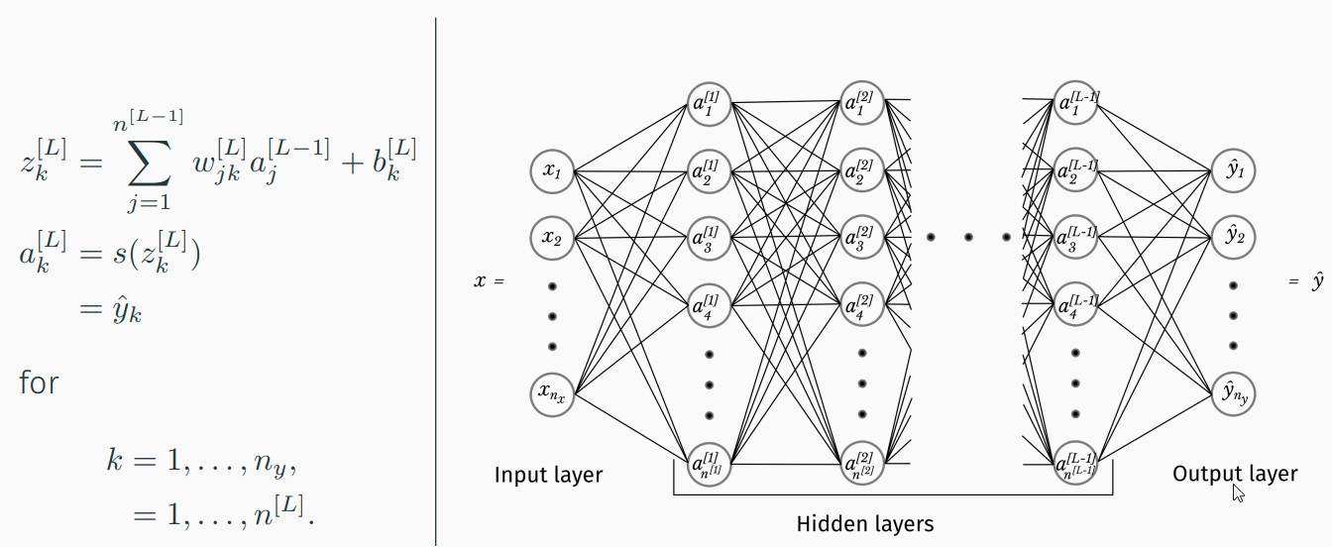
Deep Neural network model
Matrix-vector or matrix-matrix operations
The dimension is around 1K (1024) -> millions of trainable weights

Slide 7
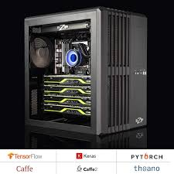
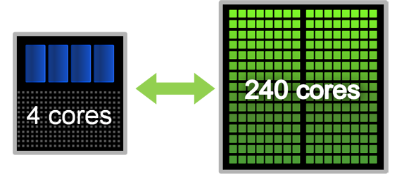
GPU and CPU
Typically GPU and CPU coexist in a heterogeneous setting (GPU is called a device, device 0, 1, …)
Control oriented part runs on CPU, and more arithmetic intensive parts run on GPU (fine-grained parallelism)
NVIDIA’s GPU architecture is called CUDA (Compute Unified Device Architecture) architecture, accompanied by CUDA programming model, and CUDA C language
Graphic
DRAM
Main memory
DRAM
PCI express bus

Slide 8
CUDA Programming Model: A Highly Multithreaded Coprocessor
The GPU is viewed as a compute device that:
Is a coprocessor to the CPU or host
Has its own DRAM (device memory)
Runs many threads in parallel
Data-parallel portions of an application are executed on the device as kernels which run in parallel on many threads
GPU runs a kernel at a time. GPU is not intended to run a complex program
Copy data from CPU to GPU
Compute on GPU
Copy data back from GPU to CPU
By default, execution on host doesn’t wait for kernel to finish
Host
Device
Grid 1
Kernel 1
Block
(0, 0)
Block
(1, 0)
Block
(2, 0)
Block
(0, 1)
Block
(1, 1)
Block
(2, 1)
Grid 2
Kernel 2
Block (1, 1)
Thread
(0, 0)
Thread
(1, 0)
Thread
(2, 0)
Thread
(3, 0)
Thread
(4, 0)
Thread
(0, 1)
Thread
(1, 1)
Thread
(2, 1)
Thread
(3, 1)
Thread
(4, 1)
Thread
(0, 2)
Thread
(1, 2)
Thread
(2, 2)
Thread
(3, 2)
Thread
(4, 2)

Slide 9

Major deep learning frameworks
pytorch (developed by Facebook) – good for model development (easy to learn)
Tensorflow/Keras (developed by Google) - good for embedded implementations through TensorFlow Lite
Caffe (developed by Facebook)
All opensource

Slide 10
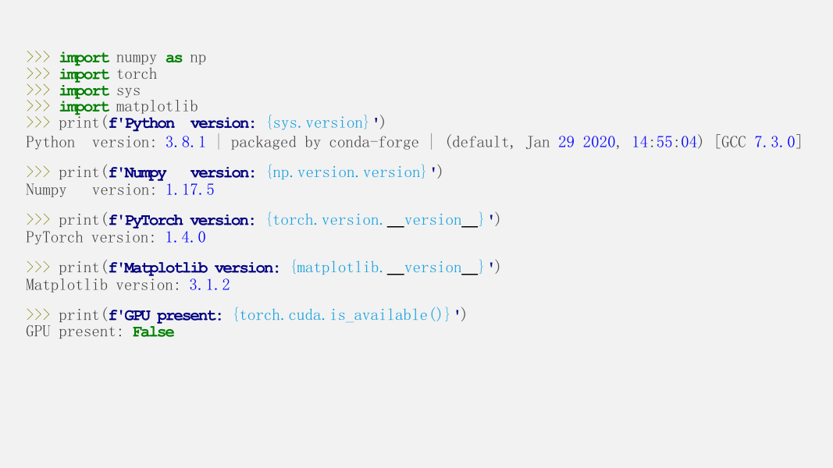
Installing pytorch

Slide 11
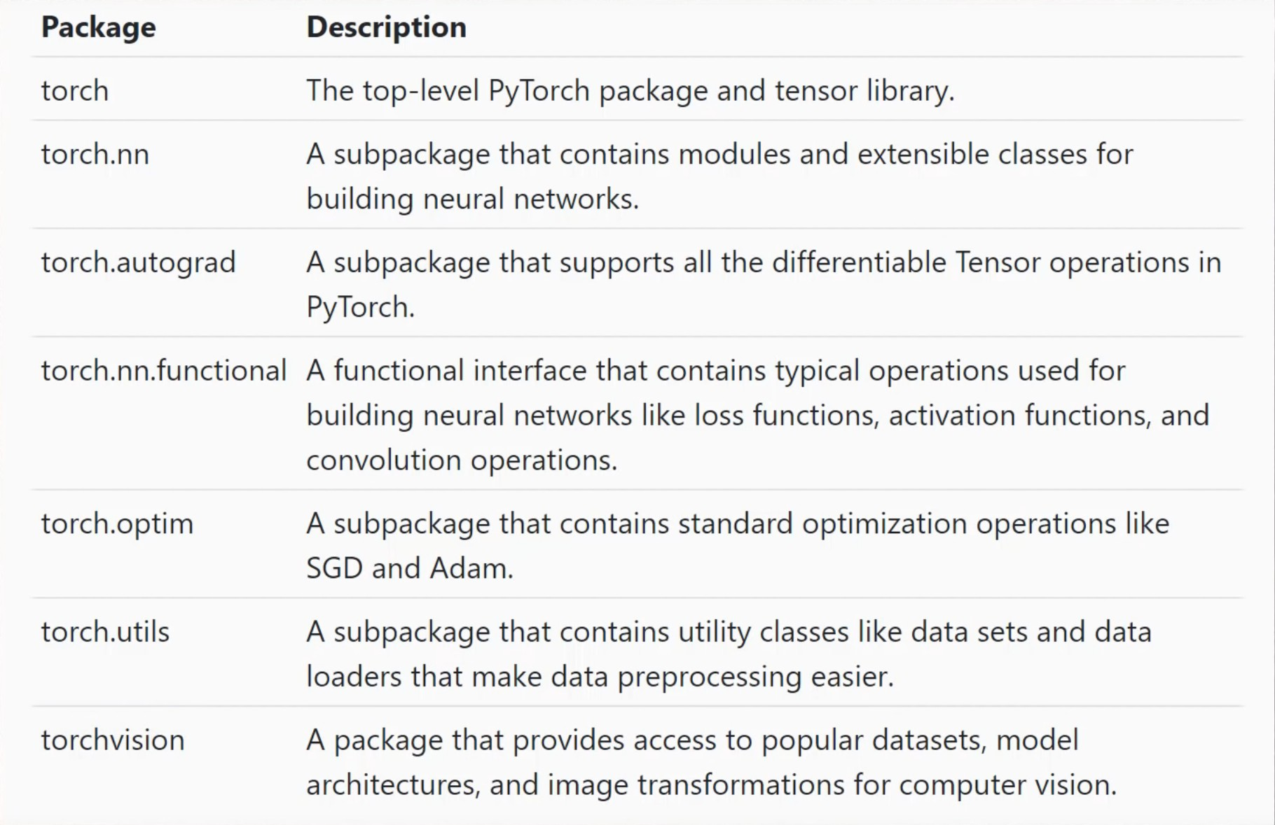

Slide 12
2. Tensors
PyTorch ’s tensors are very similar to NumPy’s ndarrays but they have a device, 'cpu', 'cuda', or 'cuda:X’ and also grad attribute supporting trainable parameters.
Tensors are similar to NumPy’s ndarrays, with the addition being that Tensors can also be used on a GPU to accelerate computing.
Common operations for creation and manipulation of these Tensors are similar to those for ndarrays in NumPy. (rand, ones, zeros, indexing, slicing, reshape, transpose, cross product, matrix product, element-wise multiplication)

Slide 13
Loading Data, Devices and CUDA
Numpy arrays to PyTorch tensors Fallback to cpu if gpu is unavailable:
torch.from_numpy(x_train) ● torch.cuda.is_available()
Returns a cpu tensor!
Check cpu/gpu tensor OR numpy array ?
PyTorch tensor to numpy
t.numpy()
Using GPU acceleration
type(t)or t.type() returns
numpy.ndarray
torch.Tensor
CPU - torch.cpu.FloatTensor
GPU - torch.cuda.FloatTensor
t.to()
Sends to whatever device (cuda or cpu)

Slide 14
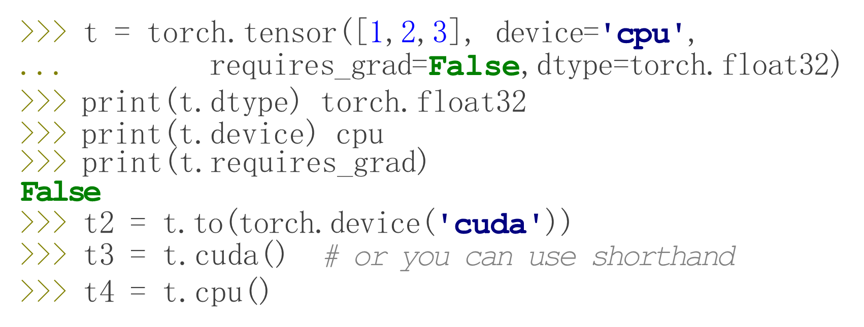
Pytorch tensor
They might require gradients (used for backpropagation based training)
Performs Tensor dtype and/or device conversion.
A torch.dtype and torch.device are inferred from
the arguments of self.to(*args, **kwargs).
This package adds support for CUDA tensor types, that
implement the same function as CPU tensors, but they utilize
GPUs for computation.

Slide 15
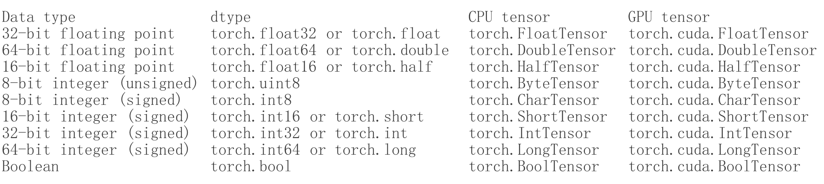
Pytorch data-types
See: https://pytorch.org/docs/stable/tensors.html

Slide 16
Creating arrays/tensor
eye: creating diagonal matrix / tensor
zeros: creating tensor filled with zeros
ones: creating tensor filled with ones
linspace: creating linearly increasing values
arange: linearly increasing integers
>>> torch.eye(3, dtype=torch.double)
tensor([[1., 0., 0.],
[0., 1., 0.],
[0., 0., 1.]], dtype=torch.float64)
>>> torch.arange(6)
tensor([0, 1, 2, 3, 4, 5])

Slide 17
IN5400 Machine learning for image analysis, 2020 spring
>>> torch.eye(2) tensor([[1., 0.],
[0., 1.]])
>>> torch.zeros(2,2) tensor([[0., 0.],
[0., 0.]])
>>> torch.ones(2,2) tensor([[1., 1.],
[1., 1.]])
>>> torch.rand(2,2) tensor([[0.6849, 0.1091],
[0.4953, 0.8975]])
>>> torch.empty(2,2) # NEVER USE IT! Creates uninitialized tensor.
tensor([[-2.2112e-16,
[-3.0981e-16,
3.0693e-41],
3.0693e-41]])
>>> torch.arange(6) tensor([0, 1, 2, 3, 4, 5])

Slide 18
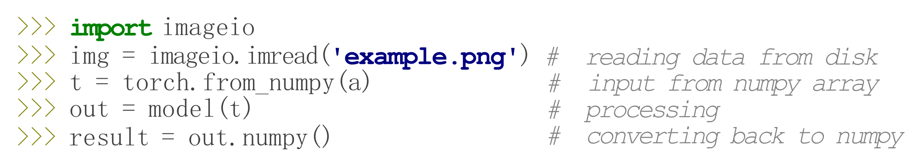
Remarks:
arrays / tensors must be on the same device.
only detached arrays can be converted to numpy (see later)
if data types are not the same, casting might be needed (v1.1 or older)
E.g. adding an integer and a float tensor together.
# tuples, lists, arrays, etc. can be converted automatically:
>>> t2 = torch.tensor(...)

Slide 19
detach()와 clone()은 기존 Tensor를 복사하는 방법 중 하나입니다.
detach() : 기존 Tensor에서 gradient 전파가 안되는 텐서 생성
단 storage를 공유하기에 detach로 생성한 Tensor가 변경되면 원본 Tensor도 똑같이 변합니다.
clone() : 기존 Tensor와 내용을 복사한 텐서 생성

Slide 20
Copying/creating new tensors
Copy data
torch.Tensor()
torch.tensor()
torch.clone()
type casting
Share Data
torch.as_tensor()
torch.from_numpy()
torch.view()
torch.reshape()
torch.Tensor
int 입력시 float으로 변환
torch 데이터 입력시 입력 받은 데이터의 메모리 공간을 사용
list, numpy 데이터 입력 시 입력 받은 데이터를 복사하여 새롭게 torch.Tensor를 만든 후 사용
torch.tensor
int 입력시 int 그대로
입력 받은 데이터를 새로운 메모리 공간으로 복사 후 사용
torch.clone ... Returns a copy of input . ... This function is differentiable, so gradients will flow back from the result of this operation to input
a = a.type(torch.float64)
print(a.dtype) # torch.float64

Slide 21
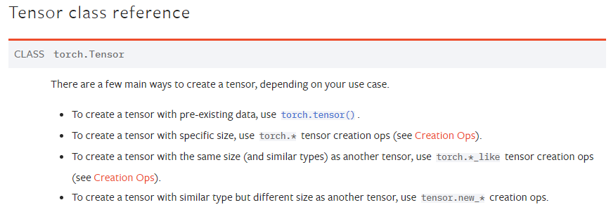
torch.tensor
int 입력시 int 그대로 입력
입력받은 데이터를 새로운 메모리 공간에 복사해 Tensor 객체 생성 (call by value)
torch.Tensor
int 입력시 float으로 변환
데이터 입력 시(Tensor 객체로) 입력 받은 메모리 공간을 그대로 사용 (call by reference)
데이터 입력 시(list나 numpy 로) 입력 받은 값을 복사하여 Tensor 객체 생성(call by value)

Slide 22
Memory: Sharing vs Copying
IN5400 Machine learning for image analysis, 2020 spring
>>> a = np.arange(6) >>> t = torch.from_numpy(a) >>> t[2] = 11 >>> t |  | # | [0,1,2,3,4,5]
tensor([ 0, 1, 11, 3, 4, | 5])
>>> a
array([ 0, 1, 11, 3, 4, | 5]) | # | Changed the underlying | numpy | array too!
>>> b = a.copy()
>>> p = t.clone()
>>> t[0] = 7
# a,t change, b, p remain intact.

Slide 23
Indexing – numpy indexing works
>>> t = torch.arange(12).reshape(3,4)
tensor([[ 0, 1, 2, 3],
[ 4, 5, 6, 7],
[ 8, 9, 10, 11]])
>>> t[1,1:3]
tensor([5, 6])
>>> t[:,:] = 0 # fill everything with 0, a.k.a. t.fill_(0)
tensor([[0, 0, 0, 0],
[0, 0, 0, 0],
[0, 0, 0, 0]])

Slide 24
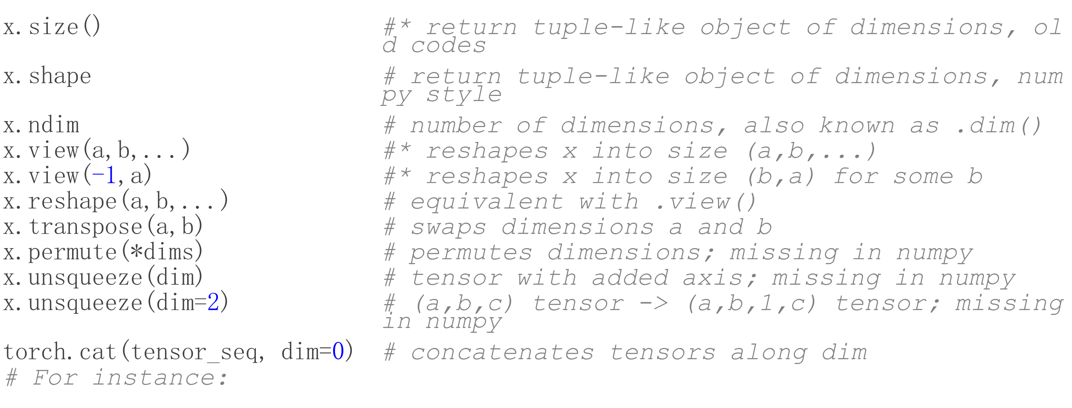

Slide 25
transpose() vs permute()
permute()와 transpose()는 유사한 방식으로 작동한다. transpose()는 딱 두 개의 차원을 맞교환할 수 있다. 그러나 permute()는 모든 차원들을 맞교환할 수 있다. 예를 들면,
x = torch.rand(16, 32, 3)
y = x.tranpose(0, 2) # [3, 32, 16]
z = x.permute(2, 1, 0) # [3, 32, 16]

Slide 26
torch.view has existed for a long time. It will return a tensor with the new shape. The returned tensor will share the underling data with the original tensor. See the documentation here.
On the other hand, it seems that torch.reshape has been introduced recently in version 0.4. According to the document, this method will
Returns a tensor with the same data and number of elements as input, but with the specified shape. When possible, the returned tensor will be a view of input. Otherwise, it will be a copy. Contiguous inputs and inputs with compatible strides can be reshaped without copying, but you should not depend on the copying vs. viewing behavior.
It means that torch.reshape may return a copy or a view of the original tensor. You can not count on that to return a view or a copy. According to the developer:
if you need a copy use clone() if you need the same storage use view(). The semantics of reshape() are that it may or may not share the storage and you don't know beforehand.
Another difference is that reshape() can operate on both contiguous and non-contiguous tensor while view() can only operate on contiguous tensor. Also see here about the meaning of contiguous.

Slide 27
>>>t = torch.arange(6)
tensor([0, 1, 2, 3, 4, 5])
>>> t.reshape(2,3) # same as t.view(2,3 or t.view(2,-1)
tensor([[0, 1, 2],
[3, 4, 5]])
>>> t.reshape(2,3).unsqueeze(1)
tensor([[[0, 1, 2]],
[[3, 4, 5]]])
>>> t.reshape(2,3).unsqueeze(1).shape
torch.Size([2, 1, 3])

Slide 28
TORCH.SQUEEZE
torch.squeeze(input, dim=None, *, out=None) → Tensor
Returns a tensor with all the dimensions of input of size 1 removed.
For example, if input is of shape: (A \times 1 \times B \times C \times 1 \times D)(A×1×B×C×1×D) then the out tensor will be of shape: (A \times B \times C \times D)(A×B×C×D).
When dim is given, a squeeze operation is done only in the given dimension. If input is of shape: (A \times 1 \times B)(A×1×B), squeeze(input, 0) leaves the tensor unchanged, but squeeze(input, 1) will squeeze the tensor to the shape (A \times B)(A×B).
>>> x = torch.tensor([1, 2, 3, 4])
>>> torch.unsqueeze(x, 0)
tensor([[ 1, 2, 3, 4]])
>>> torch.unsqueeze(x, 1)
tensor([[ 1],
[ 2],
[ 3],
[ 4]])
>>> x = torch.zeros(2, 1, 2, 1, 2)
>>> x.size()
torch.Size([2, 1, 2, 1, 2])
>>> y = torch.squeeze(x)
>>> y.size()
torch.Size([2, 2, 2])

Slide 29
Torch 사칙연산 ‘+’, add
torch.randn_like ... Returns a tensor with the same size as input that is filled with random numbers from a normal distribution with mean 0 and variance 1.
import numpy as np
import torch
x= torch.Tensor([[1.0, 2.0, 3.0], [4.0, 5.0, 6.0]])
print(x)
x1 = torch.randn_like(x, dtype=torch.float)
print(x1)
print(x.size())
y = x + x1
print(y)
torch.add(x,x1)
result = torch.empty(2, 3)
print(y.add_(x)) #In_place addition
print(result)
torch.empty ... Returns a tensor filled with uninitialized data. The shape is defined by the variable argument size
tensor([[1., 2., 3.],
[4., 5., 6.]])
tensor([[ 0.1117, 0.6287, -0.8823],
[-0.5409, -0.6151, 1.5826]])
torch.Size([2, 3])
tensor([[1.1117, 2.6287, 2.1177],
[3.4591, 4.3849, 7.5826]])
tensor([[ 2.1117, 4.6287, 5.1177],
[ 7.4591, 9.3849, 13.5826]])
tensor([[0., 0., 0.],
[0., 0., 0.]])

Slide 30
import torch
x = torch.zeros([3, 5])
print(x)
y = torch.ones([3, 5])
print(y)
c = torch.add(x, y) + 10
print(c)
d = x+y +10
print(d)
import numpy​
import torch
​
x = numpy.zeros([3, 5])
print(x)
y = numpy.ones([3, 5])
print(y)
c = numpy.add(x, y) + 10
print(c)
[[0. 0. 0. 0. 0.]
[0. 0. 0. 0. 0.]
[0. 0. 0. 0. 0.]]
[[1. 1. 1. 1. 1.]
[1. 1. 1. 1. 1.]
[1. 1. 1. 1. 1.]]
[[11. 11. 11. 11. 11.]
[11. 11. 11. 11. 11.]
[11. 11. 11. 11. 11.]]
tensor([[0., 0., 0., 0., 0.],
[0., 0., 0., 0., 0.],
[0., 0., 0., 0., 0.]])
tensor([[1., 1., 1., 1., 1.],
[1., 1., 1., 1., 1.],
[1., 1., 1., 1., 1.]])
tensor([[11., 11., 11., 11., 11.],
[11., 11., 11., 11., 11.],
[11., 11., 11., 11., 11.]])
tensor([[11., 11., 11., 11., 11.],
[11., 11., 11., 11., 11.],
[11., 11., 11., 11., 11.]])

Slide 31
# Vector + scalar
m1 = torch.FloatTensor([[1, 2]])
m2 = torch.FloatTensor([3]) # [3] -> [3, 3]
print(m1 + m2)
tensor([[4., 5.]])
# 2 x 1 Vector + 1 x 2 Vector
m1 = torch.FloatTensor([[1, 2]])
m2 = torch.FloatTensor([[3], [4]])
print(m1 + m2)
tensor([4., 5.],
[5., 6.]])

Slide 32
Common tensor operations
Common tensor operations:
reshape
max/min
shape/size
etc
Arithmetic operations
Abs / round / sqrt / pow /etc
torch.tensor’s support broadcasting
In-place operations

Slide 33
t = torch.tensor([[1., 2., 3.], [4., 5., 6.]])
print(t.dim()) # rank. 즉, 차원
print(t.size()) # shape
print(t.shape)
2
torch.Size([2, 3])
torch.Size([2, 3])

Slide 34
Sum, mean, max - dimension을 줄 수 있다.
t = torch.FloatTensor([[1, 2], [3, 4]])
print(t)
print(t.mean())
print(t.mean(dim=0))
print(t.mean(dim=1))
print("")
print(t.sum())
print(t.sum(dim=1))
print("")
print(t.max())
print(t.max(dim=1))
(dim은 pyTorch에서의 axis와 같은 개념이다.)
tensor([[1., 2.],
[3., 4.]])
tensor(2.5000)
tensor([2., 3.])
tensor([1.5000, 3.5000])
tensor(10.)
tensor([3., 7.])
tensor(4.)
torch.return_types.max(
values=tensor([2., 4.]),
indices=tensor([1, 1]))

Slide 35
Multiplication – element wise
b = torch.ones(2, 3)
print(b)
print(x*b)
print(torch.mul(x, b))
print(x.mul(b))
tensor([[1., 1., 1.],
[1., 1., 1.]])
tensor([[1., 2., 3.],
[4., 5., 6.]])
tensor([[1., 2., 3.],
[4., 5., 6.]])
tensor([[1., 2., 3.],
[4., 5., 6.]])

Slide 36
View
#View - tensor의 크기(size), 모양 (shape) 변경
y = x.view(6)
z = x.view(2, -1)
print(y)
print(z)
print(z.size())
Tensor.view(*shape) → Tensor
Returns a new tensor with the same data as the self tensor but of a different shape.
The returned tensor shares the same data and must have the same number of elements, but may have a different size.
tensor([1., 2., 3., 4., 5., 6.])
tensor([[1., 2., 3.],
[4., 5., 6.]])
torch.Size([2, 3])

Slide 37
Squeeze, unsqueeze
#Squeeze 차원을 축소
t1 = torch.rand(1, 2, 3)
print(t1.shape)
t2 = t1.squeeze()
print(t2, t2.shape)
torch.squeeze (Python function, in torch.squeeze)
torch.Tensor.squeeze (Python method, in torch.Tensor.squeeze)
torch.squeeze
torch.squeeze torch.squeeze(input, dim=None, *, out=None) → Tensor Returns a tensor with all the dimensions of input of size 1 removed. For example, if input is of shape: (A×1×B×C×1×D)(A \times 1 \times B...
torch.Tensor.squeeze
torch.Tensor.squeeze Tensor.squeeze(dim=None) → Tensor See torch.squeeze()...
torch.Size([1, 2, 3])
tensor([[0.4694, 0.4921, 0.6644],
[0.9148, 0.9279, 0.3639]]) torch.Size([2, 3])
Returns a tensor with all the dimensions of input of size 1 removed.
For example, if input is of shape: (A \times 1 \times B \times C \times 1 \times D)(A×1×B×C×1×D) then the out tensor will be of shape: (A \times B \times C \times D)(A×B×C×D)
The returned tensor shares the storage with the input tensor, so changing the contents of one will change the contents of the other.

Slide 38
>>> x = torch.tensor([1, 2, 3, 4])
>>> torch.unsqueeze(x, 0)
tensor([[ 1, 2, 3, 4]])
>>> torch.unsqueeze(x, 1)
tensor([[ 1],
[ 2],
[ 3],
[ 4]])
torch.unsqueeze(input, dim) → Tensor
Returns a new tensor with a dimension of size one inserted at the specified position.
The returned tensor shares the same underlying data with this tensor.
A dim value within the range [-input.dim() - 1, input.dim() + 1) can be used. Negative dim will correspond to unsqueeze() applied at dim = dim + input.dim() + 1.

Slide 39
Stack/cat
#stack (Numpy와 비슷)
y1 = torch.FloatTensor([1, 2])
y2 = torch.FloatTensor([3, 4])
y3 = torch.FloatTensor([5, 6])
y4 = torch.stack([y1, y2, y3])
print(y4)
#cat - tensor 를 결합하는 method (concatenate)
#Numpy의 stack과 유사하지만 쌓을 dim 이 존재해야 함. 해당 차원을 늘린 후 결합
y5 = torch.cat((y1, y2, y3), dim=0)
print(y5)
print(y5.size())
tensor([[1., 2.],
[3., 4.],
[5., 6.]])
tensor([1., 2., 3., 4., 5., 6.])
torch.Size([6])
Stack: Concatenates a sequence of tensors along a new dimension.
torch.cat(tensors, dim=0, *, out=None) → Tensor
Concatenates the given sequence of seq tensors in the given dimension. All tensors must either have the same shape (except in the concatenating dimension) or be empty.

Slide 40
chunk
#Chunk - tensor를 나눌 때 사용. 갯수를 지정
tensor([[0.9330, 0.4597, 0.3355, 0.1319, 0.7919, 0.2339],
[0.7367, 0.2848, 0.0598, 0.7489, 0.4316, 0.5963],
[0.9323, 0.3707, 0.4433, 0.0286, 0.3752, 0.8199]])
tensor([[0.9330, 0.4597],
[0.7367, 0.2848],
[0.9323, 0.3707]])
tensor([[0.7919, 0.2339],
[0.4316, 0.5963],
[0.3752, 0.8199]])
tensor = torch.rand(3, 6)
t1, t2, t3 = torch.chunk(tensor,3, dim=1)
print(tensor)
print(t1)
print(t3)

Slide 41
split
#Split - chunk와 비슷하지만 하나의 tensor당 크기를 줌
tensor = torch.rand(3, 6)
t1, t2 = torch.split(tensor,3, dim=1)
print(tensor)
print(t1)
print(t2)
torch.split(tensor, split_size_or_sections, dim=0)[SOURCE]
Splits the tensor into chunks. Each chunk is a view of the original tensor.
If split_size_or_sections is an integer type, then tensor will be split into equally sized chunks (if possible). Last chunk will be smaller if the tensor size along the given dimension dim is not divisible by split_size.
tensor([[0.4040, 0.6738, 0.3201, 0.2434, 0.1075, 0.5485],
[0.2889, 0.0171, 0.0201, 0.1304, 0.4529, 0.2064],
[0.4438, 0.4910, 0.7083, 0.7237, 0.2939, 0.9327]])
tensor([[0.4040, 0.6738, 0.3201],
[0.2889, 0.0171, 0.0201],
[0.4438, 0.4910, 0.7083]])
tensor([[0.2434, 0.1075, 0.5485],
[0.1304, 0.4529, 0.2064],
[0.7237, 0.2939, 0.9327]])

Slide 42
Torch와 numpy간의 데이터변환
#Torch <-> Numpy
# Torch tensor를 Numpy array로 변환가능 numpy(), from_numpy()
#Tensor가 CPU상에 있다면 둘이 메모리를 공유(하나 변하면 다른 것도)
x = torch.tensor([[1, 2, 3], [4, 5, 6]])
x_num = x.numpy()
print(x_num)
# x_num.add(1) <- not supported
print(x.add_(1))
print(x.numpy())
# Numpy data into tensor
import numpy as np
a = np.ones(6)
b = torch.from_numpy(a)
np.add(a, 1, out=a)
print(a)
print(b) # 하나를 바꾸어도 다른 것 바뀐다.
[2. 2. 2. 2. 2. 2.]
tensor([2., 2., 2., 2., 2., 2.], dtype=torch.float64)
[[1 2 3]
[4 5 6]]
tensor([[2, 3, 4],
[5, 6, 7]])
[[2 3 4]
[5 6 7]]

Slide 43
Cuda 와 data 옮기기
#.to method를 이용해서 CUDA 로 데이터를 옮긴다.
x = torch.tensor([[1, 2], [3, 4]])
print(x)
device = torch.device("cuda" if torch.cuda.is_available() else "cpu")
y = torch.ones_like(x, device = device)
z = x.to(device)
print(y)
print(z)
tensor([[1, 2],
[3, 4]])
tensor([[1, 1],
[1, 1]])
tensor([[1, 2],
[3, 4]])

Slide 44
# defining a PyTorch Tensor
tensor = torch.tensor([-12, -23, 0.0, 32,
1.32, 201, 5.02])
print("Tensor:\n", tensor)
# sorting the tensor in ascending order
print("Sorting tensor in ascending order:")
values, indices = torch.sort(tensor)
# printing values of sorted tensor
print("Sorted values:\n", values)
# printing indices of sorted value
print("Indices:\n", indices)
# sorting the tensor in descending order
print("Sorting tensor in descending order:")
values, indices = torch.sort(tensor, descending=True)
# printing values of sorted tensor
print("Sorted values:\n", values)
# printing indices of sorted value
print("Indices:\n", indices)
torch.sort(input, dim=- 1, descending=False, stable=False, *, out=None)
A namedtuple of (values, indices) is returned, where the values are the sorted values and indices are the indices of the elements in the original input tensor.
Tensor:
tensor([-12.0000, -23.0000, 0.0000, 32.0000, 1.3200, 201.0000, 5.0200])
Sorting tensor in ascending order:
Sorted values:
tensor([-23.0000, -12.0000, 0.0000, 1.3200, 5.0200, 32.0000, 201.0000])
Indices:
tensor([1, 0, 2, 4, 6, 3, 5])
Sorting tensor in descending order:
Sorted values:
tensor([201.0000, 32.0000, 5.0200, 1.3200, 0.0000, -12.0000, -23.0000])
Indices:
tensor([5, 3, 6, 4, 2, 0, 1])

Slide 45
import numpy
import time
import random
import array
n_d = 1024*1024
A = np.random.rand(n_d)
C = A.tolist()
t1 = time.time()
for i in range(len(C)):
C[i] = 9.0/5.0*C[i] + 32.0
t2 = time.time()
print('t2-t1=', 1000*(t2-t1))
t3 = time.time()
A = A*9.0/5.0+32.0
t4 = time.time()
print('t4-t3=', 1000*(t4-t3))
n_d = 1024*1024
A = np.random.rand(n_d)
C = A.tolist()
# print(A)
t1 = time.time()
for i in range(len(C)):
if C[i] > 0.5:
C[i]= 1.0
else:
C[i]= 0.0
t2 = time.time()
print('t2-t1=', 1000*(t2-t1))
t3 = time.time()
A[A<0.5] = 0
A[A>= 0.5]= 1
t4 = time.time()
print('t4-t3=', 1000*(t4-t3))
Run time difference
Between Python and
Numpy
t2-t1= 204.5304775238037
t4-t3= 9.982824325561523
t2-t1= 228.33490371704102
t4-t3= 28.885602951049805

Slide 46
import numpy
import time
import random
import torch
print('hello tensor')
n_d = 6
A = np.random.rand(n_d)
t = torch.tensor(A, device = 'cpu', requires_grad=False, dtype = torch.float32)
​
t3 = time.time()
t = t*1.8 +32.0
t4 = time.time()
print('t4-t3=', 1000*(t4-t3))
if n_d < 10:
print(t) #test code
print(A)
hello tensor
t4-t3= 1.9960403442382812
tensor([33.5366, 32.8331, 32.8240, 32.4005, 32.3297, 32.5646])
[0.85367155 0.46283438 0.45777846 0.22251492 0.18316694 0.31364171]
import numpy
import time
import random
import torch
print('hello tensor')
n_d = 1024*1024
A = np.random.rand(n_d)
t = torch.tensor(A, device = 'cpu', requires_grad=False, dtype = torch.float32)
​
t3 = time.time()
t = t*1.8 +32.0
t4 = time.time()
print('t4-t3=', 1000*(t4-t3))
hello tensor
t4-t3= 4.986047744750977

Slide 47
Torch.MaTMUL - 보편적인 matrix mult.
torch.dot(a, b) --- a, b (1-d) vector 의 inner product. Numpy의 dot()처럼 자유롭지 않다.
torch.mm - [n, m] x [m,p] = [n, p]
Torch.bmm – [B, n, m]x[B, m, p] = [B, n, p]
torch.matmul(a,b) 를 가장 자유롭게 사용한다.
Vector x vector
(2d) matrix x vector
(3d) Batched matrix x (1d) broadcasted vector
(3d) Batched matrix x (2d) broadcasted matrix
(3d) Batched matrix x (3d) batched matrix

Slide 48
Batch processing
GPU에서 계산할 때 GPU에 딸린 DRAM에서 data나 parameter를 읽어오는 시간이 많이 걸린다. 특히 deep neural networ은 parameter size가 엄청 큰 경우가 많다.
Image recognition 시, image 한장 가져오고, parameter 한셋 가져와서 한장의 인식을 반복
Image 100장 가져와서, parameter 한 셋 가져와서, 100장의 인식을 한번에
Parameter를 가져오는 cost는 1/100로 준다.
내부의 중간결과를 저장하는 memory size는 100배로 는다.
많은 경우 상당한 speed-up을 올릴 수 있다.
DNN 훈련의 경우 batch size를 키우면 훈련시간이 짧아지지만, 훈련 중에는 gradient 계산을 위한 중간결과 저장이 많기 때문에 DRAM size 가 부족해진다.

Slide 49
Batch processing(2)
Case 1:
(3d) Batched matrix x (2d) broadcasted matrix
Input image(2D, NxM)를 B장 처리하는데 model 은 하나를 공유한다.
(BxNxM)x(MxP) -> (BxNxP)
(3d) Batched matrix x (3d) batched matrix
Input image(2D, NxM)를 B장 처리하는데 model 도 각자이다. 모델로 B개이다.
(BxNxM)x(BxMxP) -> (BxNxP)

Slide 50
#matrix multiplication with torch.mm
t1 = torch.ones(3, 2)
t2 = torch.randn(2, 3)
t3 = torch.mm(t1, t2)
print(t1)
print(t2)
print(t3)
#batch matrix multiplication with torch.bmm
# batched matrix x batched matrix
tensor1 = torch.ones(2, 3, 4)
tensor2 = torch.randn(2, 4, 5)
t = torch.bmm(tensor1, tensor2)
print(t.size(), t)
tensor([[1., 1.],
[1., 1.],
[1., 1.]])
tensor([[-1.5497, -0.2812, -1.4817],
[ 1.8720, 0.0073, -2.2898]])
tensor([[ 0.3223, -0.2739, -3.7715],
[ 0.3223, -0.2739, -3.7715],
[ 0.3223, -0.2739, -3.7715]])
torch.Size([2, 3, 5]) tensor([[[ 1.8015, -0.3524, 1.9060, 3.4736, 0.0603],
[ 1.8015, -0.3524, 1.9060, 3.4736, 0.0603],
[ 1.8015, -0.3524, 1.9060, 3.4736, 0.0603]],
[[-0.8835, -0.2584, 1.8103, 2.1970, -0.6962],
[-0.8835, -0.2584, 1.8103, 2.1970, -0.6962],
[-0.8835, -0.2584, 1.8103, 2.1970, -0.6962]]])

Slide 51
import numpy as np
import torch
​
# vector x vector
tensor1 = torch.ones(3)
tensor2 = torch.randn(3)
print(tensor1, tensor2)
t = torch.matmul(tensor1, tensor2)
print(t, t.size())
t1 = torch.dot(tensor1, tensor2)
print(t1, t1.size())
tensor([1., 1., 1.]) tensor([1.2402, 0.1121, 0.2668])
tensor(1.6192) torch.Size([])
tensor(1.6192) torch.Size([])

Slide 52
# matrix x vector
tensor1 = torch.ones(3, 4)
tensor2 = torch.randn(4)
print(tensor1, tensor2)
t = torch.matmul(tensor1, tensor2)
print(t, t.size())
# batched matrix x broadcasted vector
tensor1 = torch.ones(2, 3, 4)
tensor2 = torch.tensor([1., 0., 2., -1.])
print(tensor1, tensor2)
t = torch.matmul(tensor1, tensor2)
print(t, t.size())
tensor([[1., 1., 1., 1.],
[1., 1., 1., 1.],
[1., 1., 1., 1.]]) tensor([-1.2745, 0.3913, -0.1453, -0.7014])
tensor([-1.7300, -1.7300, -1.7300]) torch.Size([3])
tensor([[[1., 1., 1., 1.],
[1., 1., 1., 1.],
[1., 1., 1., 1.]],
[[1., 1., 1., 1.],
[1., 1., 1., 1.],
[1., 1., 1., 1.]]]) tensor([ 1., 0., 2., -1.])
tensor([[2., 2., 2.],
[2., 2., 2.]]) torch.Size([2, 3])

Slide 53
# batched matrix x broadcasted matrix
tensor1 = torch.randn(4, 3, 2)
tensor2 = torch.tensor([[1.], [-1.]]) #(2.1) dimension
t = torch.matmul(tensor1, tensor2)
print(t, t.size())
tensor([[[-0.7888],
[ 2.0835],
[ 0.3500]],
[[-0.7603],
[ 1.7824],
[-0.4314]],
[[ 0.7845],
[ 0.3543],
[-0.7257]],
[[ 0.7852],
[ 0.3909],
[-0.7192]]]) torch.Size([4, 3, 1])

Slide 54
tensor([[[ 1.1631, -1.1644, -0.5849, 0.1162],
[ 1.1636, 1.7263, 0.3073, 1.0364],
[-2.1449, -0.0396, 0.9080, -0.0368]],
[[ 0.6111, -1.1104, -0.1103, -1.2444],
[ 0.4317, -0.8696, 0.5541, 0.4554],
[ 0.9930, -0.3079, -1.3046, -0.2256]]]) tensor([[[ 1.5313, -0.3276, 2.7772, -0.4481, 0.1965],
[ 1.5952, -0.0919, 1.1515, -0.3580, -1.6283],
[-0.4292, -1.2339, 0.6714, -0.7756, -1.6151],
[ 1.2285, -0.2973, 1.0524, 1.2427, 0.0254]],
[[-0.7885, -0.3905, -1.6923, 1.9778, 0.0136],
[-2.1463, -0.4651, -0.5532, -0.7155, -0.7816],
[-0.2973, -0.4352, 1.3212, -0.2860, -2.0298],
[-1.3526, -0.4848, 0.7136, -0.5906, -0.7557]]])
tensor([[[ 0.3174, 0.4132, 1.6188, 0.4937, 3.0720],
[ 5.6770, -1.2271, 6.5166, -0.0897, -3.0522],
[-3.7826, -0.4032, -5.4315, 0.2252, -1.8244]],
[[ 3.6173, 0.9290, -1.4537, 2.7697, 2.0405],
[ 0.7453, -0.2261, 0.8075, 1.0487, -0.7834],
[ 0.5709, 0.4325, -3.3947, 2.6907, 3.0726]]]) torch.Size([2, 3, 5])
# batched matrix x batched matrix
tensor1 = torch.randn(2, 3, 4)
tensor2 = torch.randn(2, 4, 5)
print(tensor1, tensor2)
t = torch.matmul(tensor1, tensor2)
print(t, t.size())

Slide 55
Torch tensor summary
Very similar to numpy (indexing, main functions)
Every tensor has a device, a type, and a required_grad attribute Conversion and/or device transfer might be needed.
In-place operations end in underscore, e.g. .fill_()
Some operations create new tensors, some share data. Careful with the broadcasting semantics.
Remark: not just tensors are similar to ndarrays, but torch functions are also similar to numpy functions.

Slide 56
3. Computational graph and autograd

Slide 57
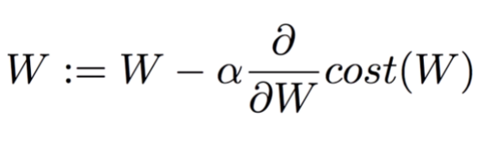
인공신경망의 훈련
DNN은 내부에 매우 많은 parameter (weight 라 함)를 가지고 있다.
초기에 일정크기의 random number 로 초기화된다.
Supervised learning 에서는 입력 data를 넣었을 때 해당 weight 로 얻은 결과가 desired value 와 다른 값인 cost 를 구한다.
이 cost 값이 작아지도록 weight 를 조금씩 바꾼다.
Weight (W) 를 바꾸려면 derivate cost/derivate weight 의 값을 알아야 한다.
문제 – 신경망의 깊이가 깊은 것.

Slide 58
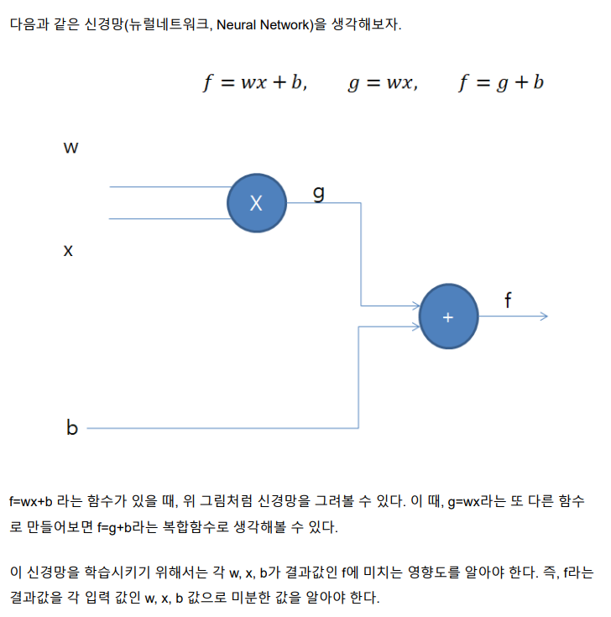
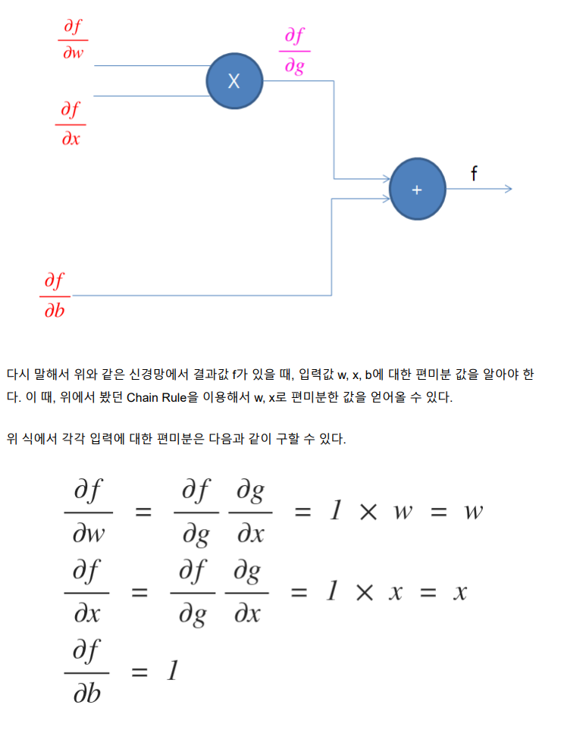

Slide 59


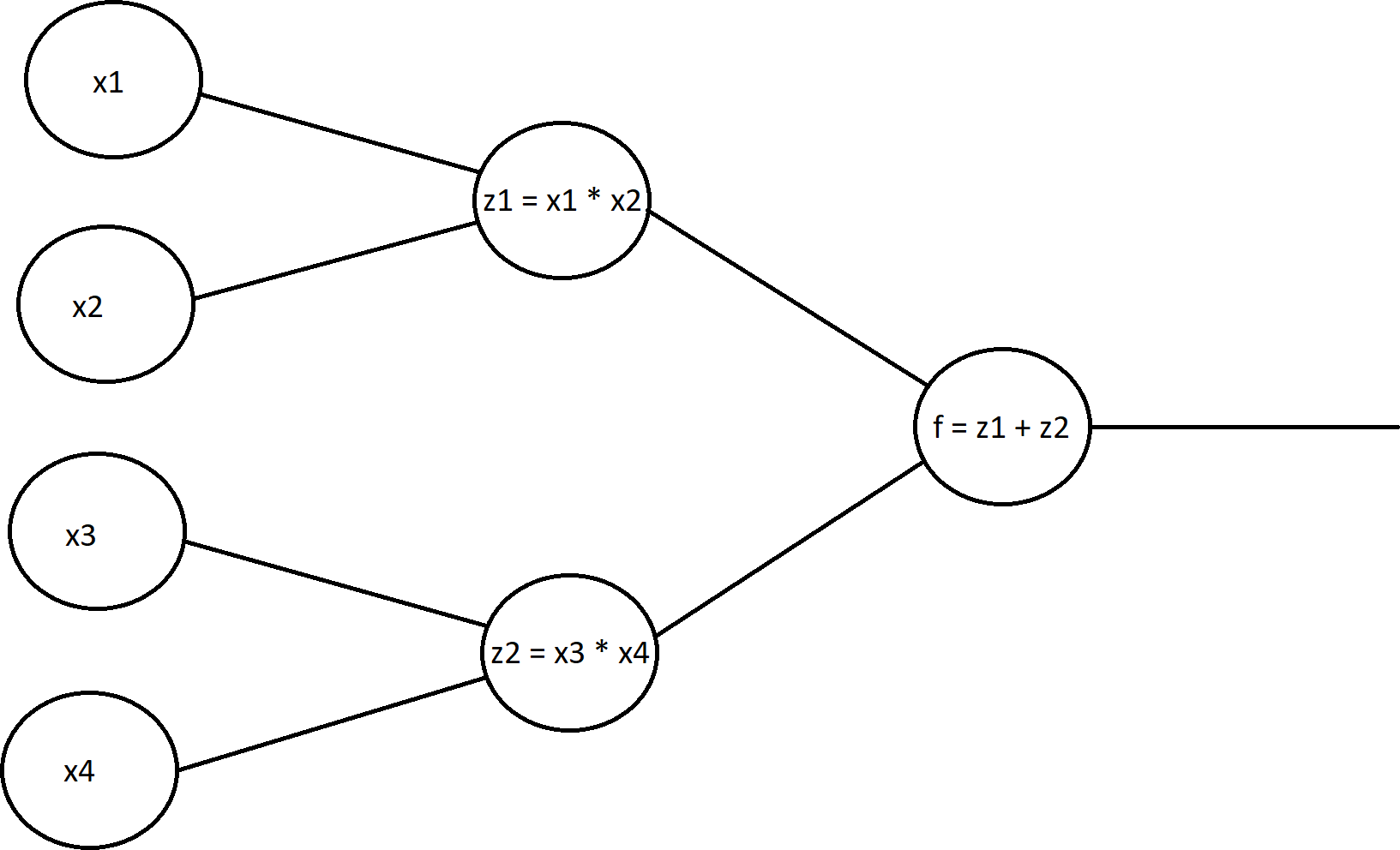
Computational graph

Slide 60
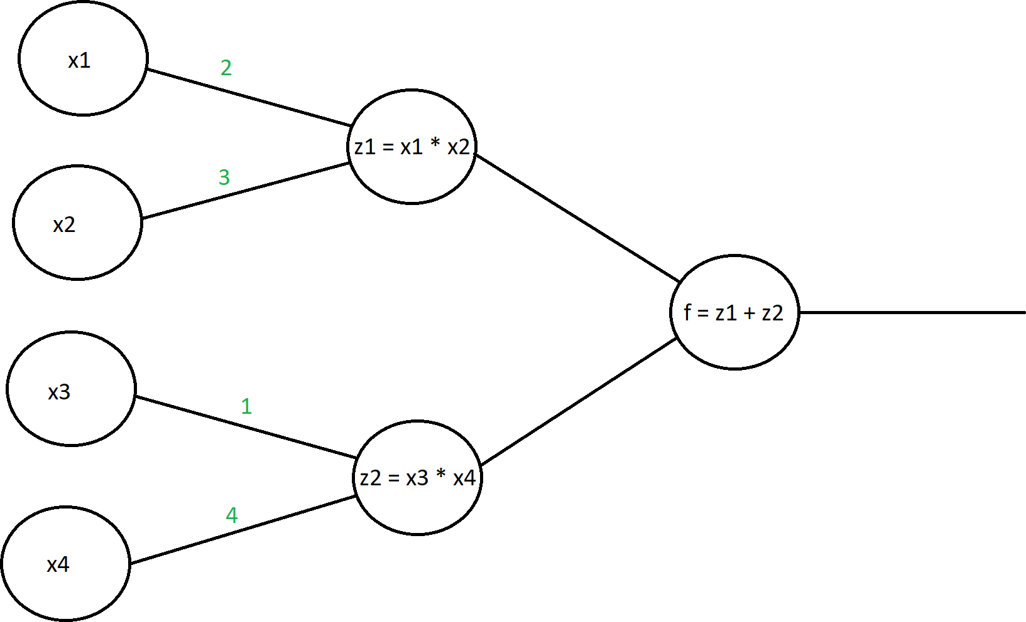
Forward propagation
IN5400 Machine learning for image analysis, 2020 spring

Slide 61

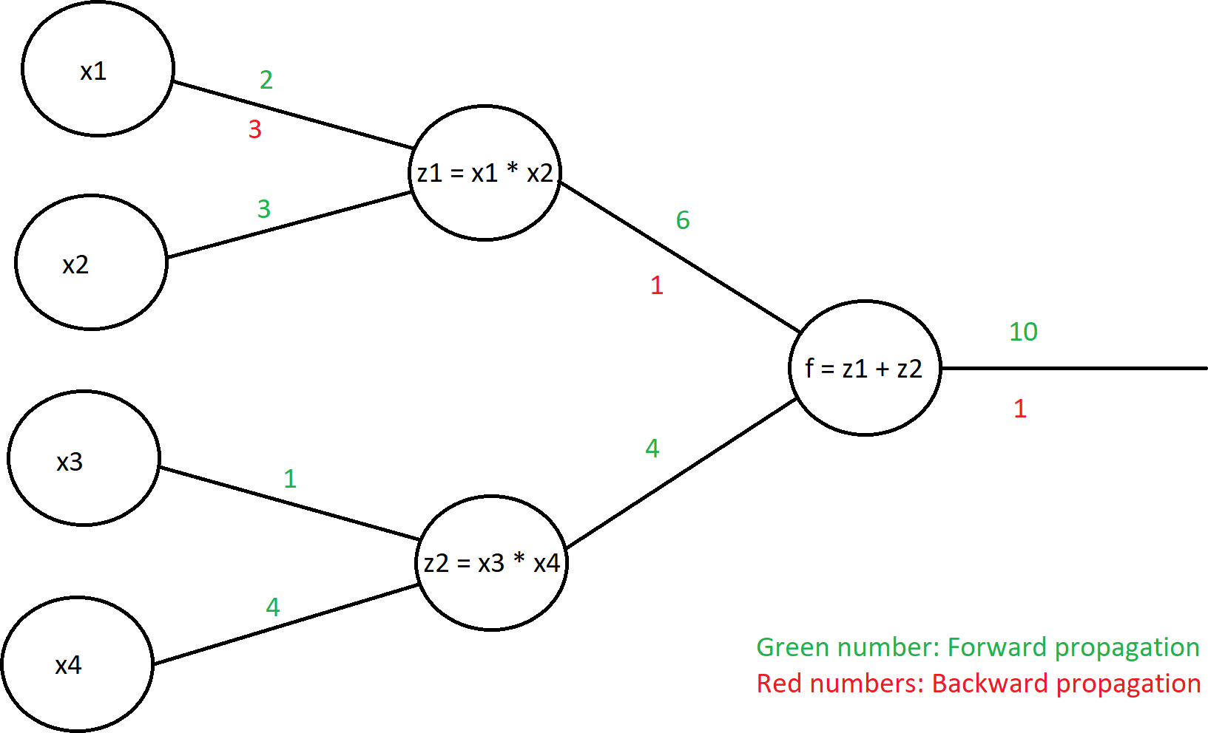
IN5400 Machine learning for image analysis, 2020 spring
Backward propagation
What if we want to get the derivative of f with respect to the x1?

Slide 62
IN5400 Machine learning for image analysis, 2020 spring
Autograd - Automatic differentiation for all operations on Tensors Static computational graph (TensorFlow 1.0)
Dynamic computational graph (PyTorch) – 매 iteration마다 바뀔 수 있다.
The backward graph is defined by the forward run!

Slide 63
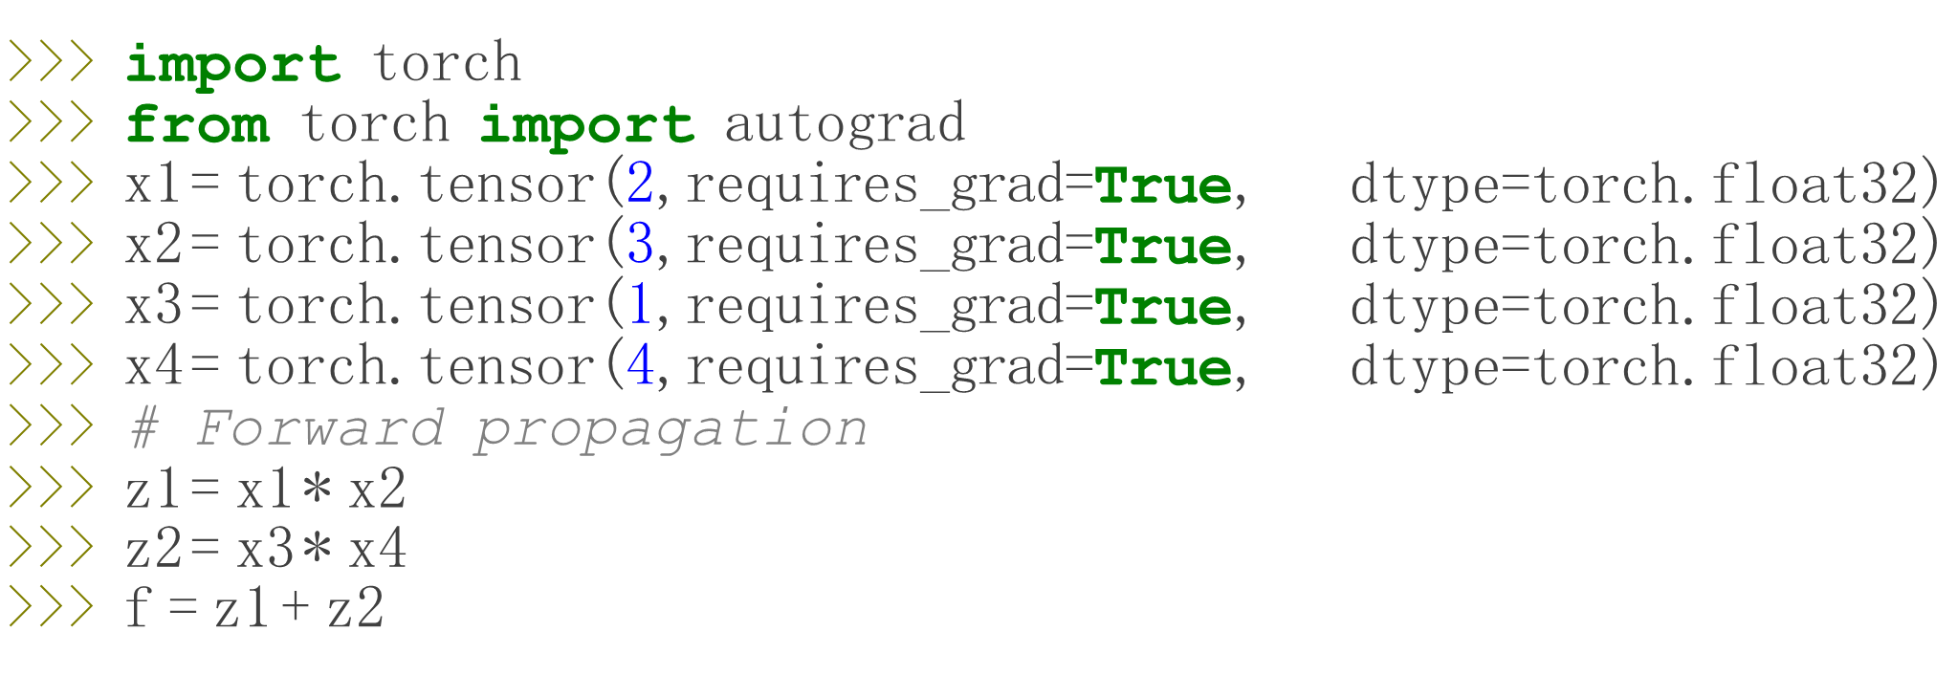
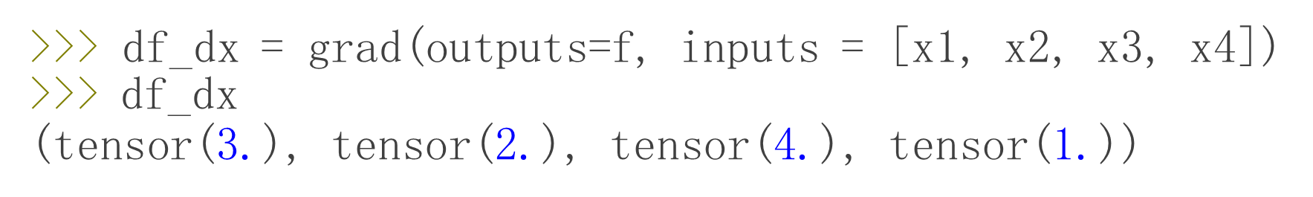
Example of autograd

Slide 64
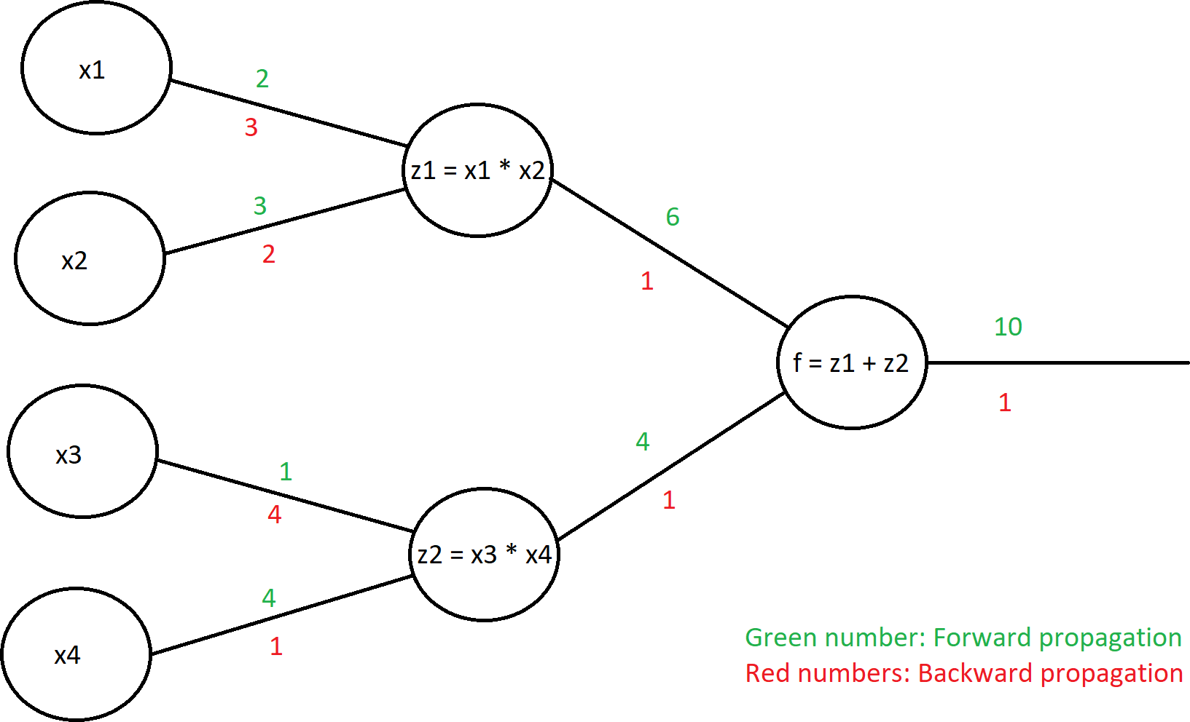
IN5400 Machine learning for image analysis, 2020 spring
>>> df_dx = grad(outputs=f, inputs = [x1, x2, x3, x4])
>>> df_dx
(tensor(3.), tensor(2.), tensor(4.), tensor(1.))

Slide 65
Leaf tensor
IN5400 Machine learning for image analysis, 2020 spring
A «leaf tensor» is a tensor you created directly, not as the result of an operation.
>>> x = torch.tensor(2)
>>> y = x + 1
# x is a leaf tensor
# y is not a leaf tensor
Remember the computation graph:
x1, x2, x3, x4 are the leaf tensors.

Slide 66
IN5400 Machine learning for image analysis, 2020 spring
The need for specifying all tensors is inconvenient.
>>> | import torch
>>> | from torch import autograd
>>> | x1 = torch.tensor(2, requires_grad=True, | dtype=torch.float32)
>>> | x2 = torch.tensor(3, requires_grad=True, | dtype=torch.float32)
>>> | x3 = torch.tensor(1, requires_grad=True, | dtype=torch.float32)
>>> | x4 = torch.tensor(4, requires_grad=True, | dtype=torch.float32)
>>> | # Forward propagation
>>> | z1 = x1 * x2
>>> | z2 = x3 * x4
>>> | f = z1 + z2
>>> | # df_dx = grad(outputs=f, inputs = [x1, | x2, x3, x4]) # inconvenient
>>> | f.backward() | # that is better!
>>> print(f" f's derivative w.r.t. x1 is {x.grad}") tensor(3.)
Chain rule is applied back to all the leaf tensors with requires_grad=True
attribute.

Slide 67
IN5400 Machine learning for image analysis, 2020 spring
We can locally disable/enable gradient calculation with torch.no_grad()
torch.enable_grad()
or using the @torch.no_grad @torch.enable_grad decorators
>>> x = torch.tensor([1], requires_grad=True)
>>> with torch.no_grad():
... y = x * 2
>>> y.requires_grad
False
>>> with torch.no_grad():
... with torch.enable_grad():
... y = x * 2
>>> y.requires_grad
True
Note: Use «torch.no_grad()» during inference

Slide 68
https://www.youtube.com/watch?v=MswxJw-8PvE
https://pytorch.org/docs/stable/autograd.html

Slide 69
Loading Data, Devices and CUDA
Numpy arrays to PyTorch tensors Fallback to cpu if gpu is unavailable:
torch.from_numpy(x_train) ● torch.cuda.is_available()
Returns a cpu tensor!
Check cpu/gpu tensor OR numpy array ?
PyTorch tensor to numpy
t.numpy()
Using GPU acceleration
type(t)or t.type() returns
numpy.ndarray
torch.Tensor
CPU - torch.cpu.FloatTensor
GPU - torch.cuda.FloatTensor
t.to()
Sends to whatever device (cuda or cpu)

Slide 70
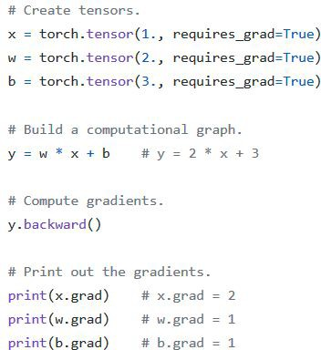
Autograd
Automatic Differentiation Package
Don’t need to worry about partial differentiation, chain rule etc.
backward() does that
Gradients are accumulated for each step by default:
Need to zero out gradients after each update
tensor.grad_zero()

Slide 71
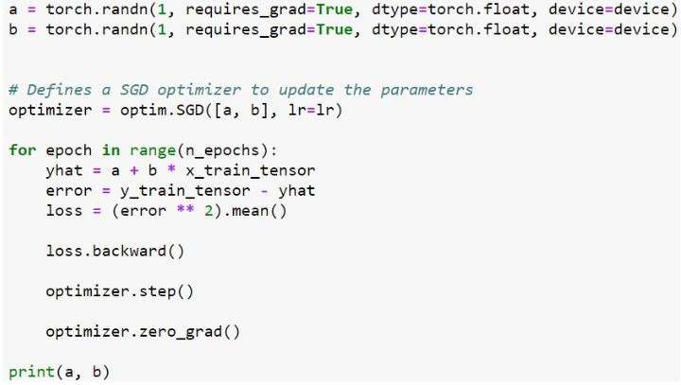
Optimizer and Loss
Optimizer
Adam, SGD etc.
An optimizer takes the parameters we want to update, the learning rate we want to use along with other hyper-parameters and performs the updates
Loss
Various predefined loss functions to choose from
L1, MSE, Cross Entropy

Slide 72
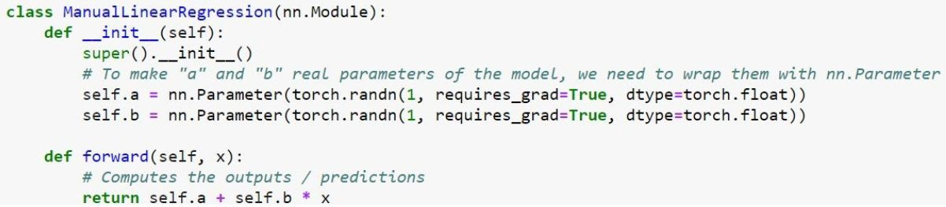
Model
In PyTorch, a model is represented by a regular Python class that inherits from the Module class.
Two components
init (self): it defines the parts that make up the model- in our case, two parameters, a and b
forward(self, x) : it performs the actual computation, that is, it outputs a prediction, given the inputx
파이썬 클래스 상속 : super().__init__()

